Slide 1
IPC Accessories Installation Guide
2022-01-17

Slide 2


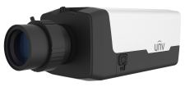

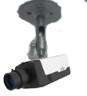
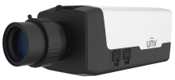
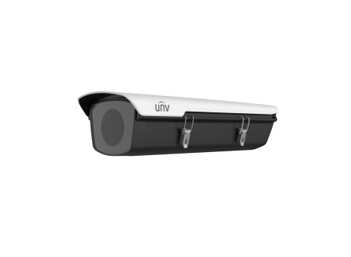
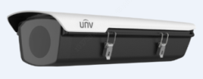
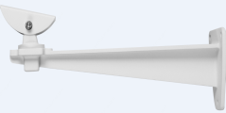

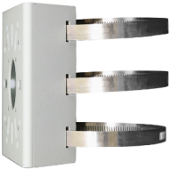
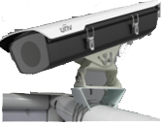
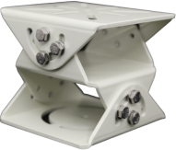

Box camera mount
Indoor Wall mount
Indoor installation:
Pendent mount
TR-WM06-C-IN
IPC54X/IPC56X series
TR-UM06-A-IN
Outdoor installation
(-20 ℃~60 ℃)
HS-217S-B-NB
TR-WM06-I-IN
Wall mount
Outdoor installation
(-40 ℃~70 ℃)
HS-217SHB-B-NB
Outdoor installation
(-40 ℃~70 ℃)
HS-217SHB-IR-B-NB
TR-UV06-A-IN
Horizontal Pole mount
TR-UP06-IN Pole mount

Slide 3
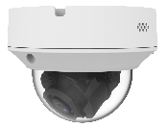
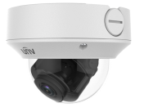
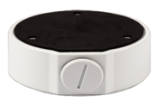

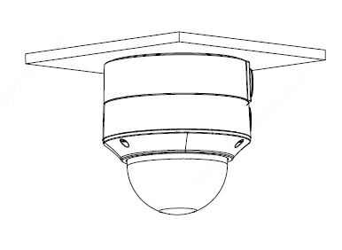

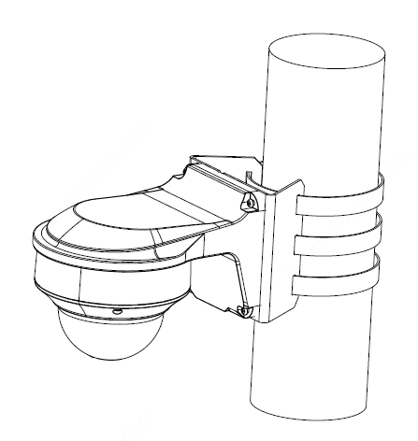


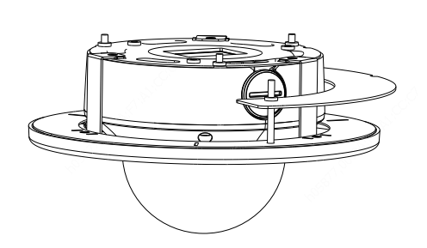
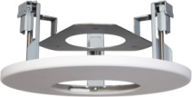
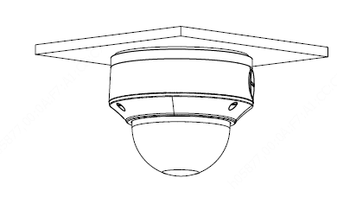
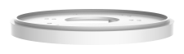
Dome camera mount
NPT ¾”Plastic
Waterproof joint
Mic
Junction box
Optional
IPC323X series
TR-JB04-C-IN
TR-A01-IN
Wall mount
(Junction box)
TR-JB07/WM04-B-IN
Wall mount
Pole mount
TR-WM04-IN
TR-UP06-IN
In-ceiling mount
TR-FM152-A-IN
Electric-box Transfer plate
TR-SM04-IN
(美国NEMA-WD6标准)

Slide 4
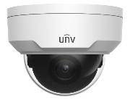
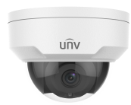
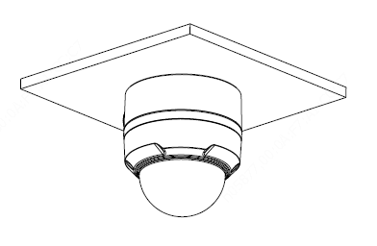

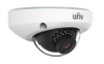
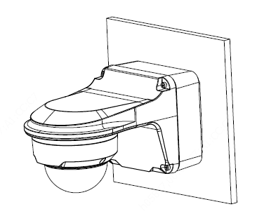
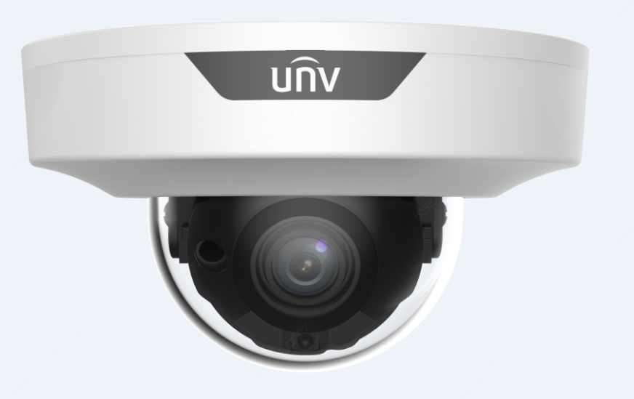
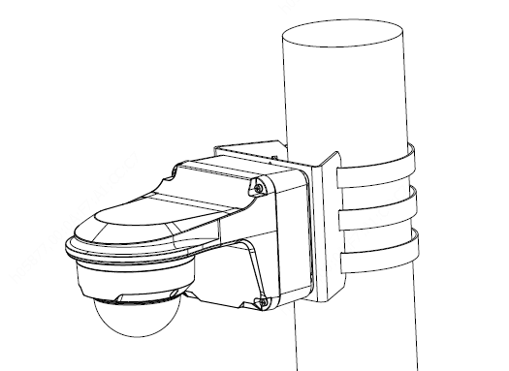


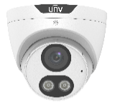
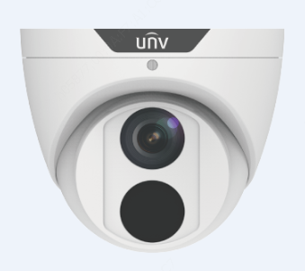
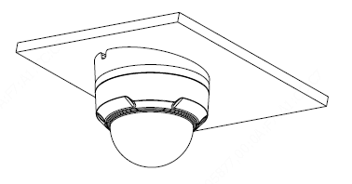

Dome camera mount
NPT ¾”Plastic
Waterproof joint
Junction box
Optional
IPC32X SS\SB\LB\LE series
IPC32X S/E/L series
TR-JB03-G-IN
TR-A01-IN
Wall mount
(Junction box)
IPC31X
TR-JB07/WM03-G-IN
PRIME series
IPC354SR3
Wall mount
Pole mount
TR-WM03-D-IN
TR-UP06-IN
IPC361X SE series
IPC3616\361X SS \361XSB series
Tilted mounting
TR-UM06-E-IN

Slide 5
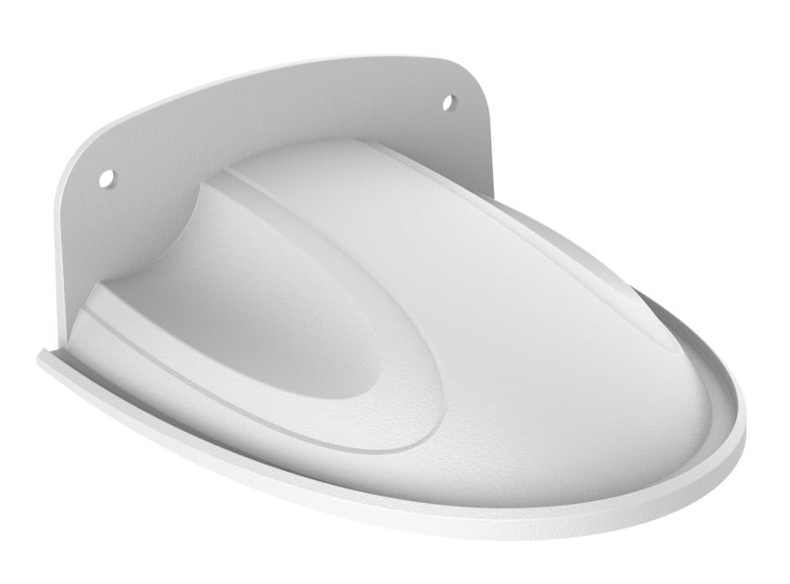
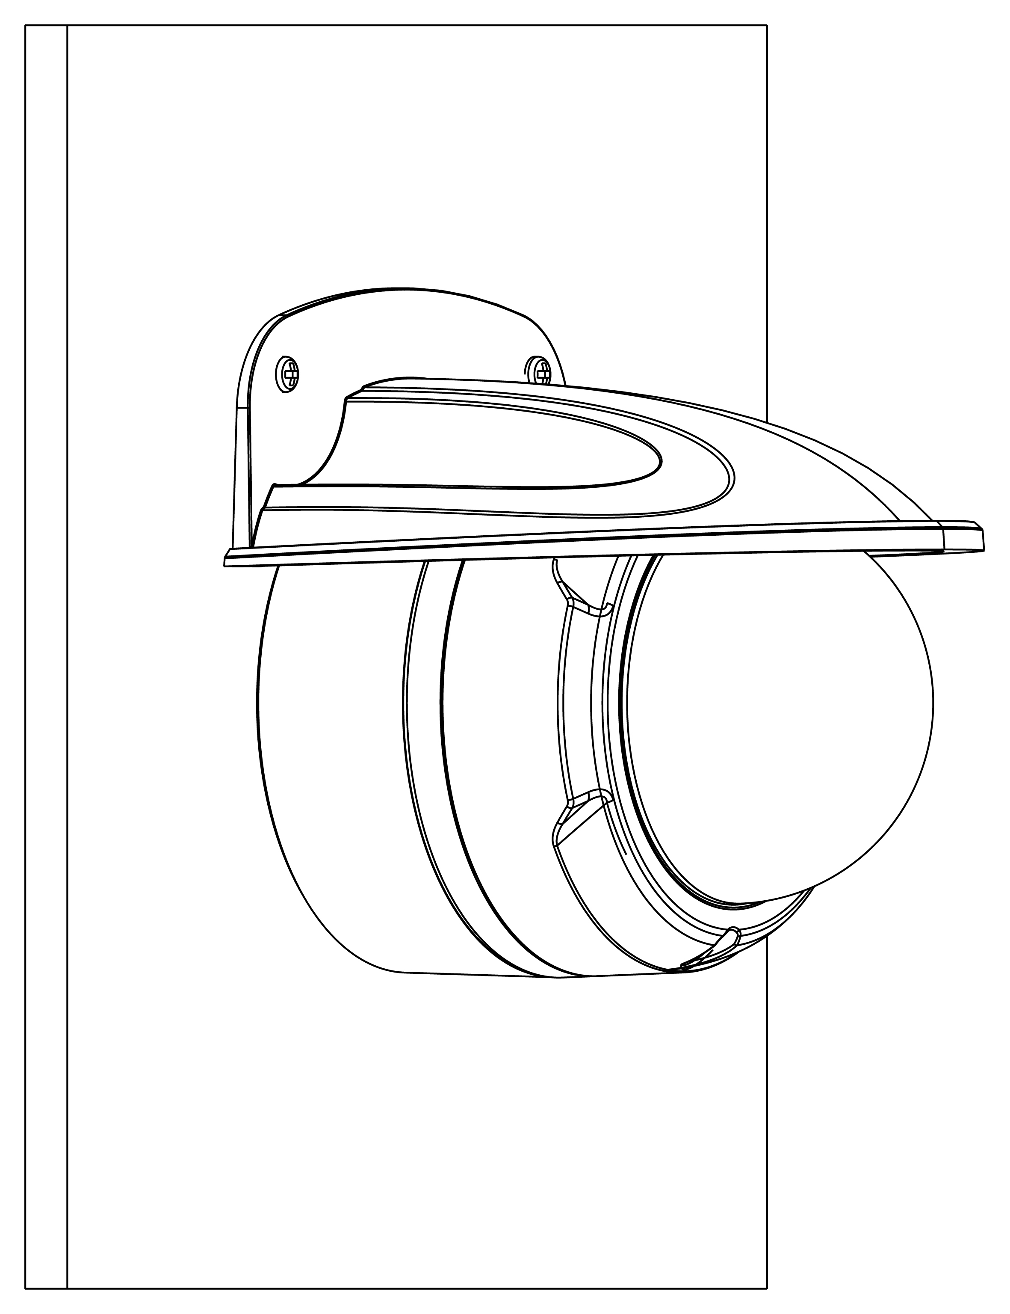
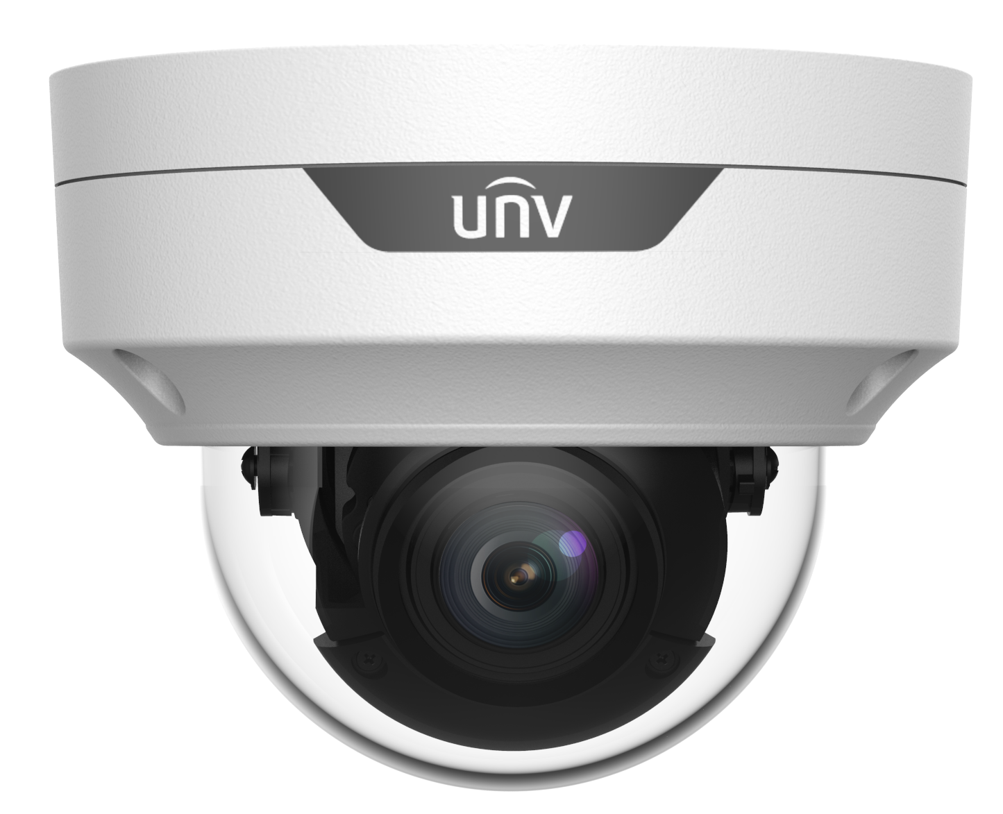
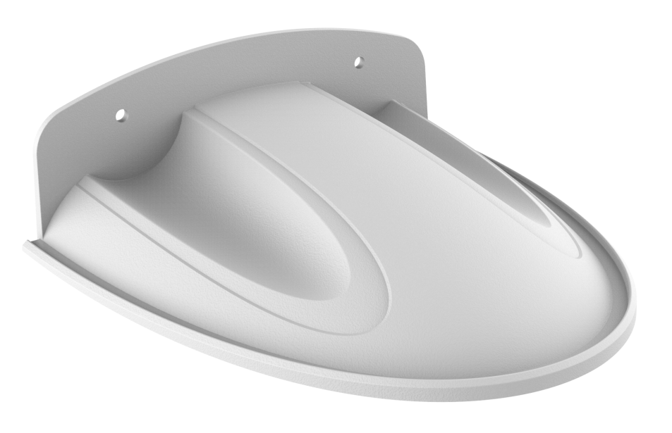
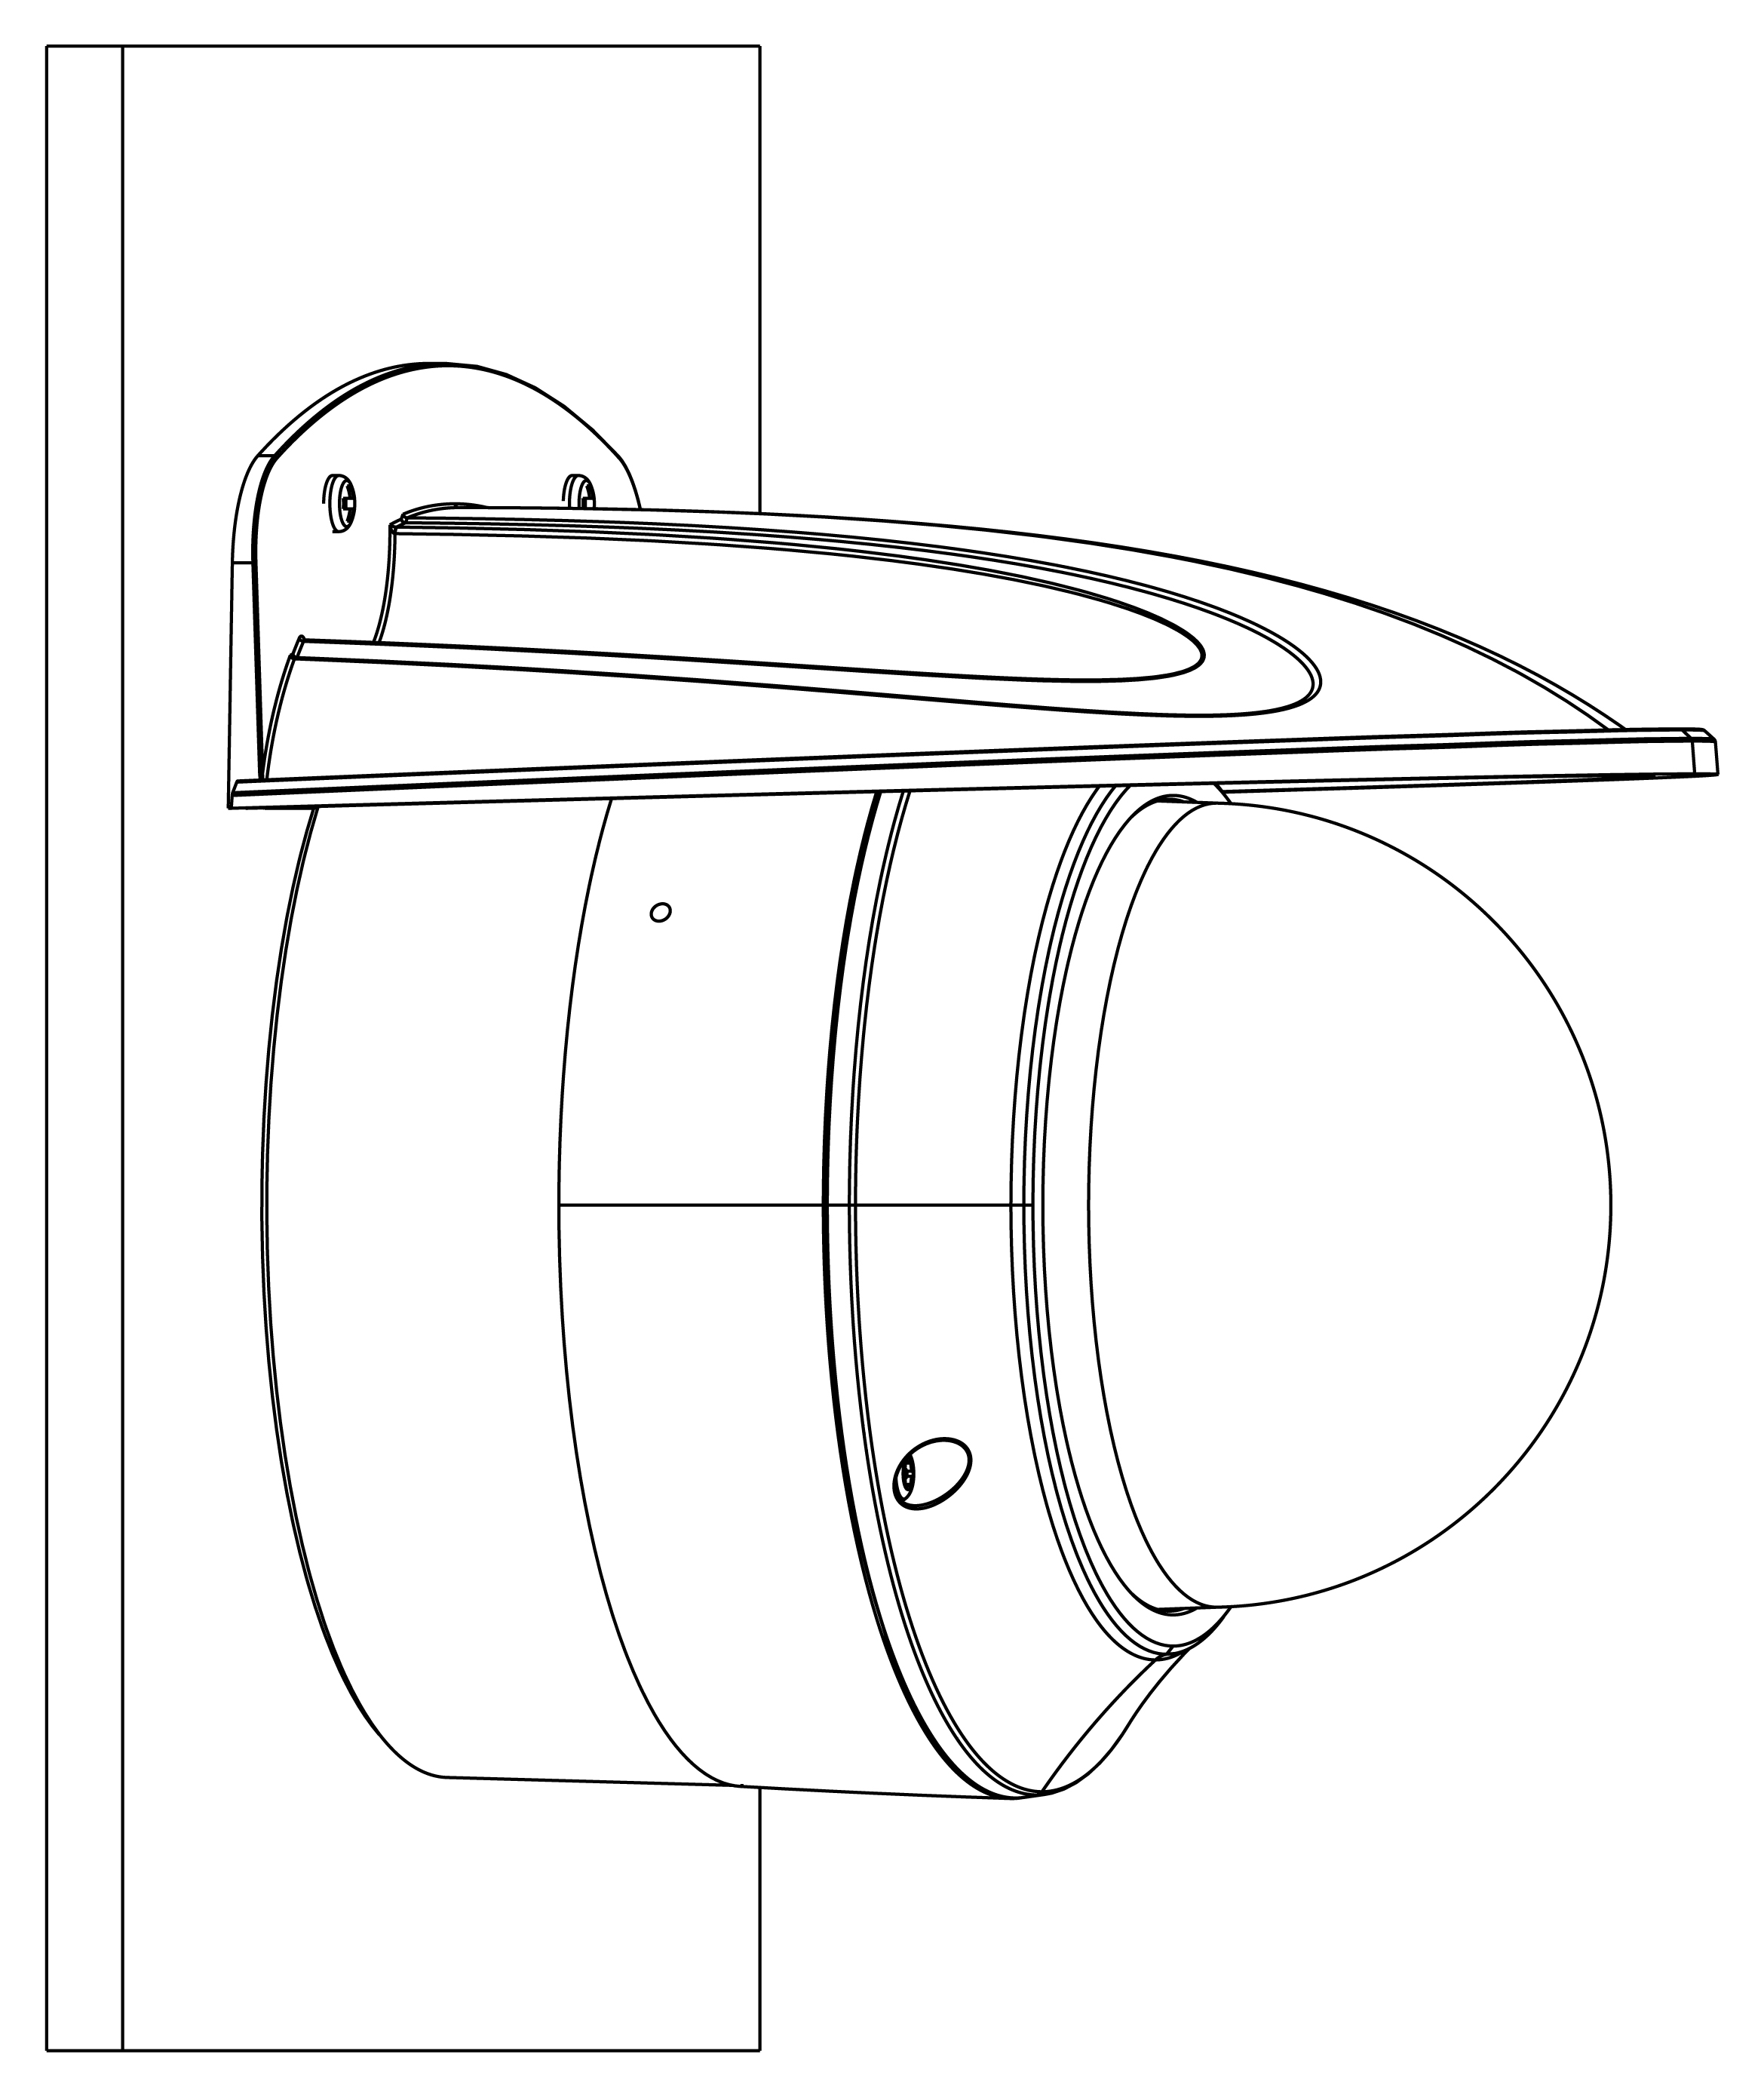
Dome camera mount
Junction box
Wall mount
IPC32X SS\SB\LB\LE series
IPC32X S/E/L series
TR-JB03-G-IN
HS-205S
Junction box
Wall mount
PRIME/EASY series
IPC353X
TR-JB03-H-IN
Mic
Junction box
Wall mount
IPC323X series
TR-JB04-C-IN
HS-207S

Slide 6
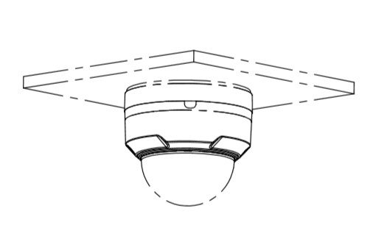
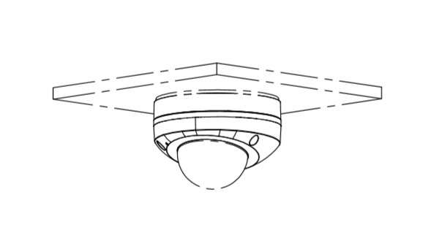
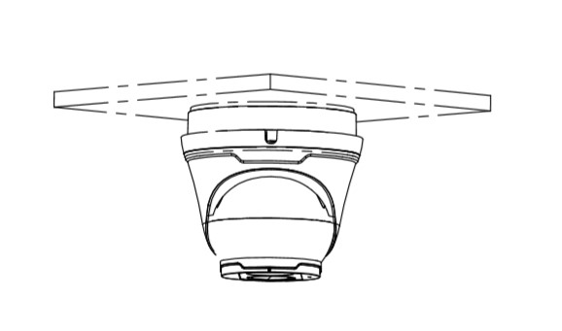
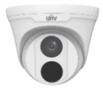

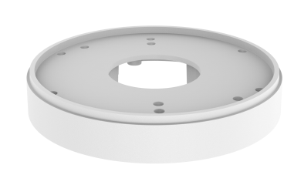
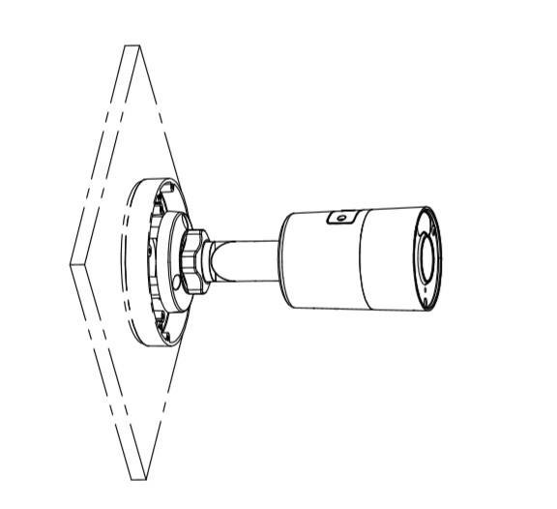
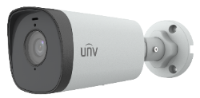
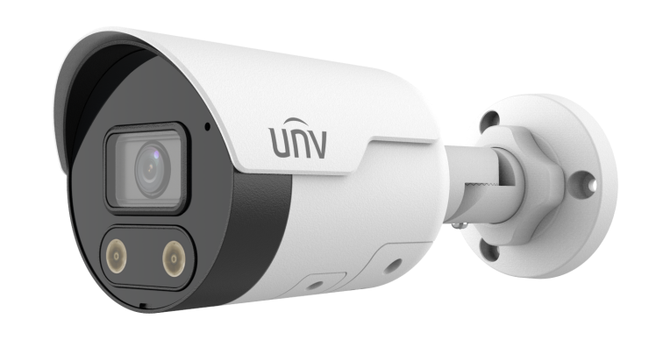
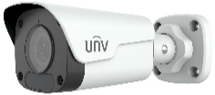
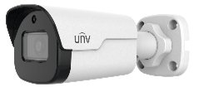
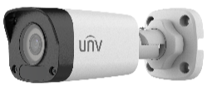

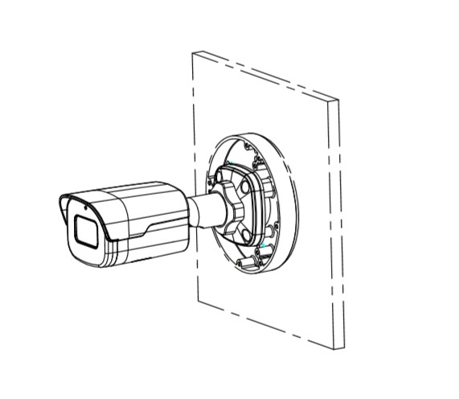
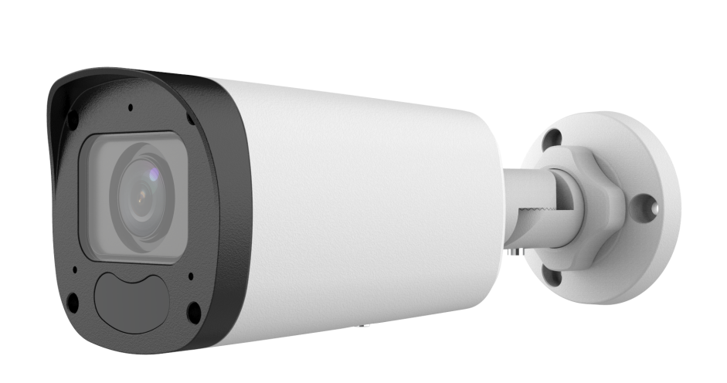
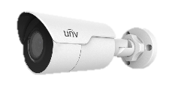
Electric-box Transfer plate
IPC32X SS\SB\LB\LE series
IPC32X S/E/L series
IPC31X
PRIME series
IPC354SR3
Electric-box Transfer plate
PRIME series
IPC361XSR -F
EASY series
IPC361XL\LE
TR-SM03-IN
(美国NEMA-WD6标准)
IPC361X SE series
IPC3616\361X SS \361XSB series
IPC231X SB
IPC2128 SB
EASY/PRIME series
IPC21XX
IPC232X LB
IPC21XX
(Round mount)

Slide 7
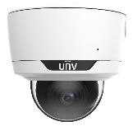
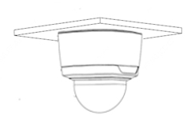
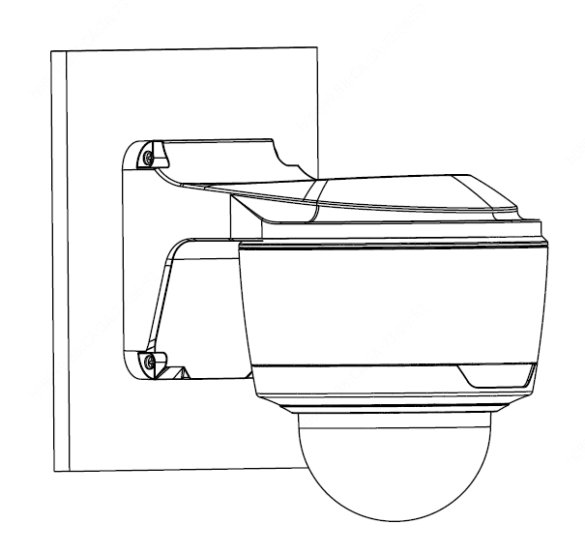


Dome camera mount
Celling mount
IPC373XSE series
Wall mount
Pole mount
TR-WM04-IN
TR-UP06-IN
Pendent mount adaptor is for indoor.
Outdoor installation should take care of waterproof.
TR-CM24-IN
(NPT ¾ 200mm)

Slide 8
















Dome camera mount
NPT ¾”Plastic
Waterproof joint
Junction box
TR-JB03-I-IN
Optional
PRIME series
IPC361XSR -F
EASY series
IPC361XL/LE
Wall mount
(Junction box)
TR-A01-IN
TR-JB07/WM03-G-IN
Wall mount
Pole mount
TR-WM03-D-IN
TR-UP06-IN
NPT ¾”Plastic
Waterproof joint
PRIME/EASY series
IPC363X
PRIME series
IPC361X S/E
Junction box
TR-JB03-H-IN
Optional
TR-A01-IN
Wall mount
(Junction box)
Mini PTZ series
IPC64XX
PRIME/EASY series
IPC353X
TR-JB07/WM03-F-IN
Wall mount
Pole mount
IPC363x SS\SA\SB series
IPC363x SE
series
TR-UP06-IN
TR-WM03-B-IN

Slide 9




Fisheye camera mount
Junction box
Optional
TR-JB04-D-IN
TR-A01-IN
868 fisheye
NPT ¾”Plastic
Waterproof joint
Junction box
Optional
TR-JB03-H-IN
TR-A01-IN
814 fisheye
NPT ¾”Plastic
Waterproof joint
815 fisheye

Slide 10





Dome camera Indoor pendent mount
*Release: 2019Q1
Junction box
IPC323X series
+
TR-JB04-C-IN
PRIME series
IPC363X
Indoor pendent mount
PRIME series
IPC361X S/E
Mini PTZ
TR-SE24-IN
(NPT ¾ 200mm lengthen)
TR-JB03-H-IN
+
PRIME series
IPC353X
Optional
Pendent mount adaptor is for indoor.
Outdoor installation should take care of waterproof.
IPC361X LB/LE
IPC361X SR -F
+
TR-JB03-I-IN
IPC32X series
IPC31X series
TR-CM24-IN
(NPT ¾ 200mm)
+
TR-JB03-G-IN
IPC354 series
IPC3616 series
IPC361X SS/SB series
868 fisheye
+
TR-JB04-D-IN
814 fisheye
815 fisheye
TR-SE24-A-IN
(NPT ¾ 500mm lengthen)
+
TR-JB03-H-IN
Optional
IPC373XSE series
Notes:
2018-11-8update：为解决北美客户要求所有半球产品可吊装需求
新开模具：搭配新藏线盒使用
1、200mm吊杆（带吸顶盘）TR-CM24-IN ；
2、200mm加长杆TR-SE24-IN搭配CM24使用；
3、500mm加长杆TR-SE24-A-IN搭配CM24使用；
（加长杆下部为外螺纹，上部为内螺纹，理论上可无限加长）

Slide 11



















Bullet camera mount
Junction box
TR-JB07-D-IN
NPT ¾”Plastic
Waterproof joint
Optional
IPC23XX series
TR-JB06-A-IN
TR-A01-IN
IPC222X series
Pole mount
Recommended side outlet for cable
IPC74X series
26X series
2AX series
Pole mount
TR-UP06-C-IN
TR-UP06-B-IN
Junction box
NPT ¾”Plastic
Waterproof joint
Optional
IPC252 series
IPC254 series
TR-JB07-D-IN
TR-A01-IN
Pole mount
Recommended side outlet for cable
Pole mount
TR-UP06-C-IN
TR-UP06-B-IN

Slide 12








Bullet camera mount
Wall mount
TR-WM06-F
IPC2C2X
Wall mount
Pole mount
TR-WM06-C-IN
TR-UP06-B-IN
IPC2A2X
Pendent mount
TR-UM06-A-IN

Slide 13




Mini Bullet camera mount
Pole mount
TR-UP06-B-IN
EASY/PRIME series
IPC21XX
Pole mount
Junction box
TR-JB05-A-IN
TR-UP06-C-IN
NPT ¾”Plastic
Waterproof joint
Junction box
TR-A01-IN
IPC231X SB
IPC2128 SB
Optional
TR-JB05-B-IN
(Round)
IPC232X LB
IPC21XX
(Round mount)
Notes:
2018-11-15update：
藏线盒后走线孔向内增加NPS3/4管螺纹，支持安装旋塞，解决亚太客户反馈藏线盒防水问题；
新增圆形藏线盒解决北美客户圆形酒杯不协调问题；
涉及以下款型：
1、TR-JB05-A-IN 替代 TR-JB05-IN，后走线孔向内增加NPS3/4管螺纹，计划时间：2018-12
2、新增圆形TR-JB05-B-IN，计划时间：2019Q1
3、新增TR-UP06-C-IN，计划时间：2019Q1

Slide 14






Bullet camera mount
Wall mount
IPC262EB-HDX10K-I0
Pendent mount
2A2XSE series
Pole mount
Pole mount
TR-UP06-C-IN
Recommended side outlet for cable
TIC2621SR-F3-4F4AC-VD

Slide 15







Positioning system mount
Junction box
TR-JB07-D-IN
NPT ¾”Plastic
Waterproof joint
Optional
IPC672 Series
TR-A01-IN
Pole mount
Recommended side outlet for cable
Pole mount
TR-UP06-C-IN
IPC6312 Series
TR-UP06-B-IN
Pendent mount
IPC675 Series
TR-CM06-A

Slide 16


















PTZ camera mount
Pendent mount adaptor
(support side cabling)
Pendent mount adaptor is for indoor.
Outdoor installation should take care of waterproof.
TR-UF45-A-IN
Pendent mount (500mm)
Pendent mount adaptor
(support side cabling)
Pendent mount (200mm)
TR-SE45-A-IN
TR-UF45-A-IN
TR-SE45-IN
Pendent mount (200mm)
(support side cabling)
IPC62xx Series
IPC63xx Series
IPC66xx Series
TR-CE45-IN
Wall mount
(Shorter bracket)
Pole mount
TR-WE45-IN
Steel：TR-UP08-A-IN
Al Alloy：TR-UP08-B-IN
IPC6424SR-X25-VF
Wall mount
(Longer bracket)
TR-JB12-IN
Corner mount
TR-WE45-A-IN
Steel ：TR-UC08-A-IN
Al Alloy ： TR-UC08-B-IN
Wall mount
(Swan neck bracket)
TR-WE45-B-IN

Slide 17













PTZ camera mount
Pendent mount adaptor
(support side cabling)
Pendent mount adaptor is for indoor.
Outdoor installation should take care of waterproof.
TR-UF45-A-IN
Pendent mount (500mm)
Pendent mount adaptor
(support side cabling)
IPC68xx Series /TIC6831ER-F50-4X38P
Pendent mount (200mm)
TR-SE45-A-IN
TR-UF45-A-IN
TR-SE45-IN
Pendent mount (200mm)
(support side cabling)
TR-CE45-IN
Pole mount
Steel：TR-UP08-A-IN
Al Alloy：TR-UP08-B-IN
TR-JB12-IN
Wall mount
(Longer bracket)
Corner mount
TR-WE45-A-IN
Steel ：TR-UC08-A-IN
Al Alloy ： TR-UC08-B-IN
Wall mount
(Swan neck bracket)
TR-WE45-B-IN

Slide 18












Indoor PTZ camera mount
In-ceiling mount
TR-FM200-IN
Shorter bracket
Indoor wall mount
TR-WE45-IN
Longer bracket
TR-WE45-A-IN
IPC6222EI Series
Adaptor
Swan neck bracket
TR-UF45-H-IN
TR-WE45-B-IN
Indoor pendent mount
TR-CE45-IN
Pendent mount (500mm)
Indoor pendent mount
TR-SE45-A-IN
Pendent mount (200mm)
TR-CE45-IN
TR-SE45-IN

Slide 19










Indoor PTZ camera mount
Junction Box
(Optional)
TR-WE45-D-IN
TR-JB07-D-IN
Pendent mount
TR-CM06-C-IN
IPC8542ER5-DUG/P
2D Bracket Mount
Pole mount
TR-UV06-C-IN
TR-UP06-IN
Wall Mount
Pole mount Adapter
TR-WE45-D-IN
TR-UP06-B-IN

Slide 20




Omniview Network Camera + PTZ dome mount
Omniview Network Camera
+
PTZ dome
wall mount
TR-WE45-E-IN
pole mount
KIT-TR4-1

Slide 21






Positioning system mount
IPC76xx Series
wall mount
2115C08G
Pedestal installation
No accessory
It is necessary to ensure that the mounting base is firm enough

